Slide 1



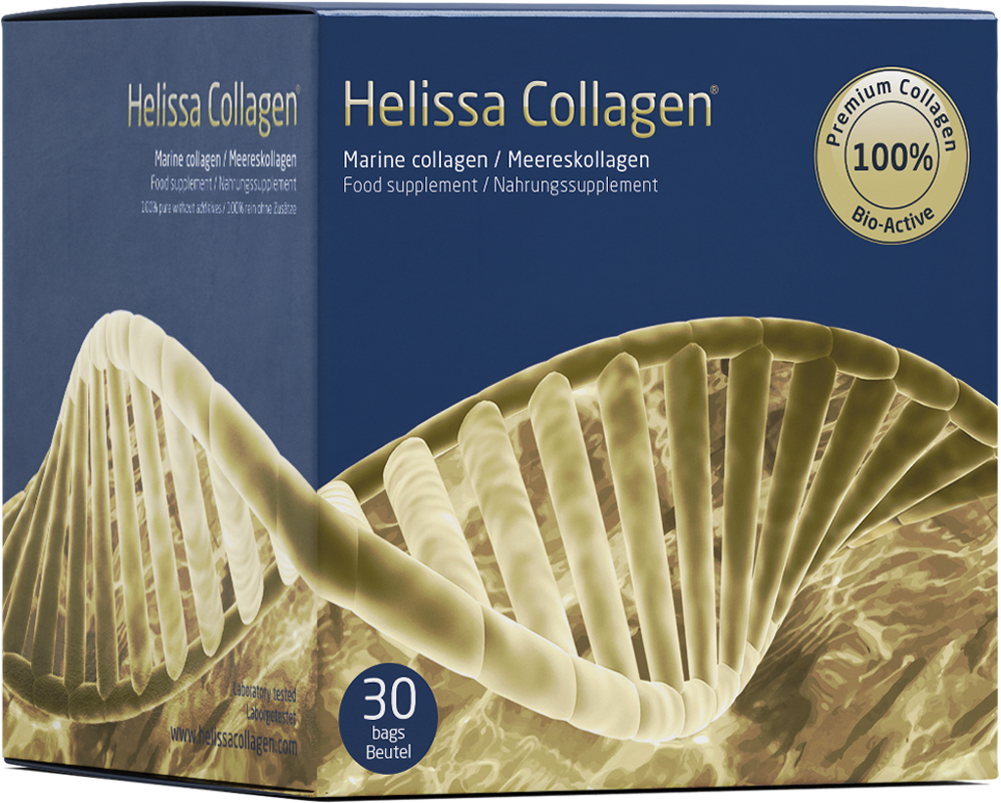
Customer tested collagen that really helps

Slide 2
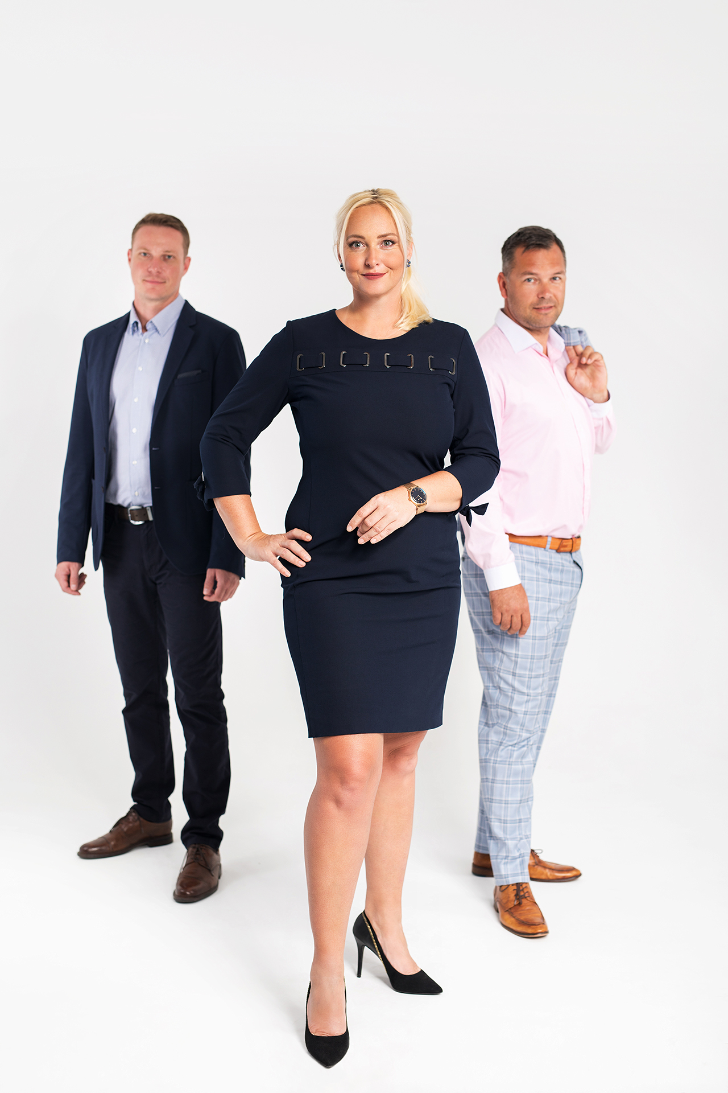
Our vision
The strong lady Romana Ljubasová overflowing with energy stands behind the establishment of the Helissa Collagen brand. She deeply loves nature and people. This influenced also the philosophy of her company founded on the idea of mutual help and spreading positive energy and the good.

Slide 3
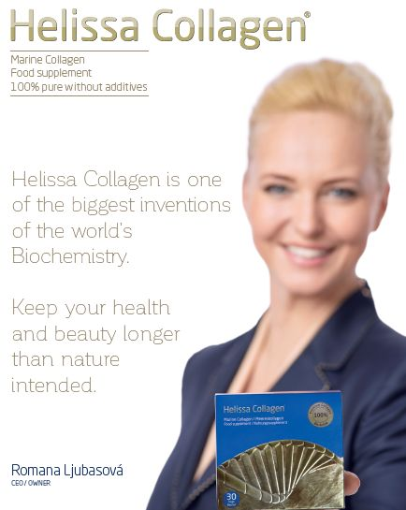
Beyond the history
Today, Helissa Collagen has thousands of enthusiastic users all over the world. You can buy it in all Czech pharmacies.
Particularly women who appreciate the ability Helissa Collagen to eliminate stretch-marks and to improve the condition of skin, hair and nails praise it.

Slide 4
Beyond the history
Helissa Collagen is a Czech product based on quality and purity oft he raw material. As it is a premium collagen, strict inspections are part of its processing and selection. Not only customers, but also experts as physicians and pharmacist recommend it due to its purity, certified bio-activity and proved effects.
Since 2015, when it was introduced to the marketplace as one of the first hydrolysed collagens, it won favour with customers together with their trust. At present, the product helped more than 100.000 customers and it continues to win trust for a new product, a collagen preparation for animals, called Incapet Collagen.

Slide 5
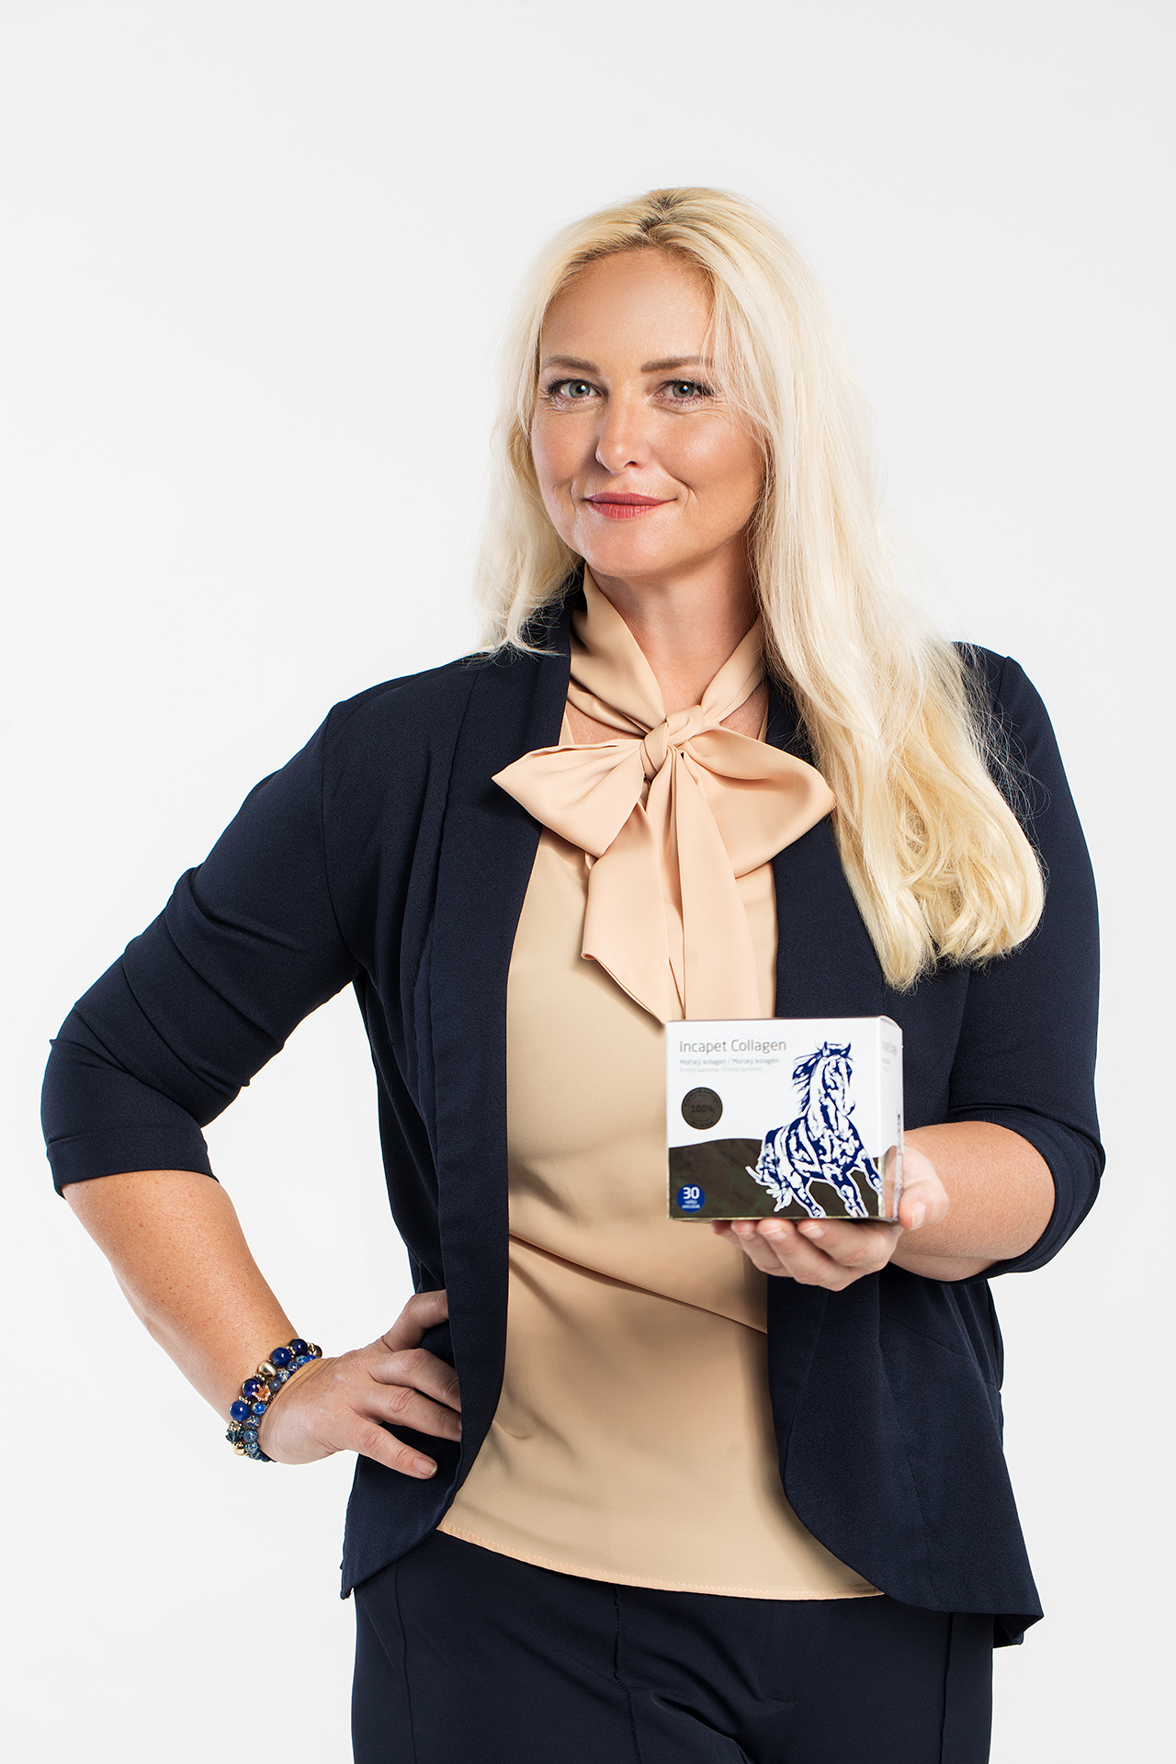



Tested quality
The company has received several certificates of product purity and quality and repeatedly defended them. They include the bio-activity certificate confirming purity and effect of collagen and its "live" molecule. Simultaneously, the product was awarded the mark "Made in the Czech Republic" by a company supporting domestic producers. It confirmed that Incapet Collagen was tested in humans.

Slide 6
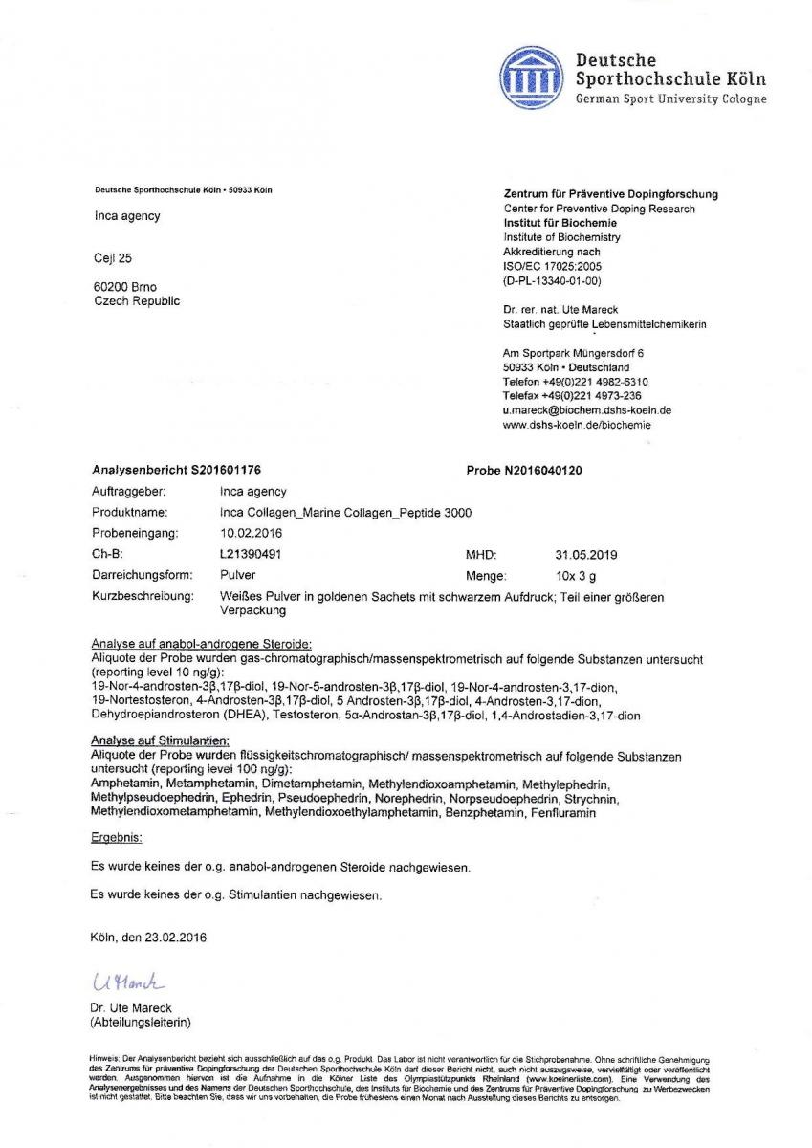
Arguments of advantages - why Helissa Collagen?
Helissa Collagen was awarded the certificate by an anti-doping laboratory confirming its absolute safety and soundness for use by sports(wo)men. This laboratory is widely respected as an authority in the aspects of doping control at Olympic Games. This certificate means that even top sports(wo)men do not need to doubt its acceptability when taking it. It confirms that Helissa Collagen is a pure and really high-quality preparation.

Slide 7
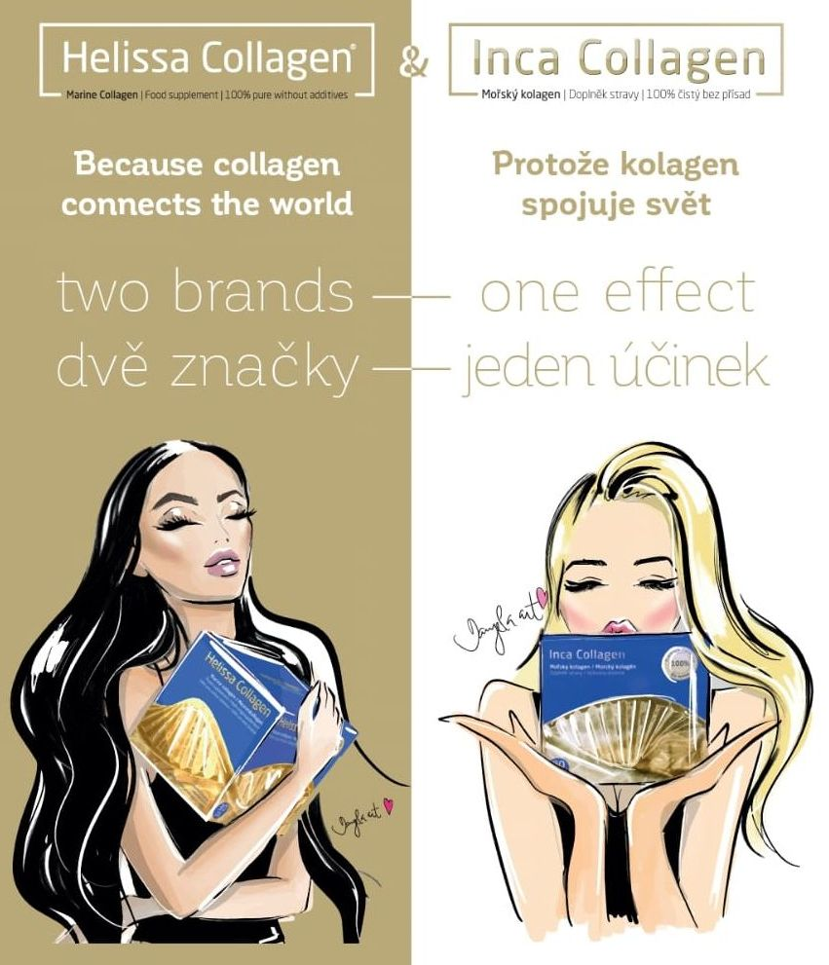
Two brands – one effect
2015 - Inca Collagen is the product of INCA-Agency s.r.o.
2016 - Continued turnover growth, philosophy and exclusivity of the Inca Collagen brand and high standard of customer friendly attitude.
2017 - After the success of Inca Collagen in Germany, a new brand needs to be found for it due to a brand conflict with another product; thus, a new name comes into being - Helissa Collagen.

Slide 8
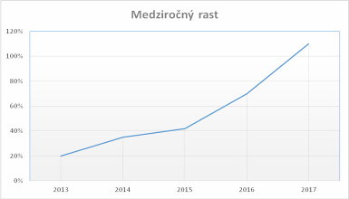
Company progress
The basic yearly growth rate was
in 2016 compared to 2015: 309%,
in 2017 compared to 2016: 154%
The export share to EU companies was:
in 2016: 40%,
in 2017: 57%
Basic half-year growth rate:
year half: II.2015 I.2016 II.2016 I.2017 II.2017 I.2018
Basic growth rate [%] + 64 +129 +68 +17 +7

Slide 9
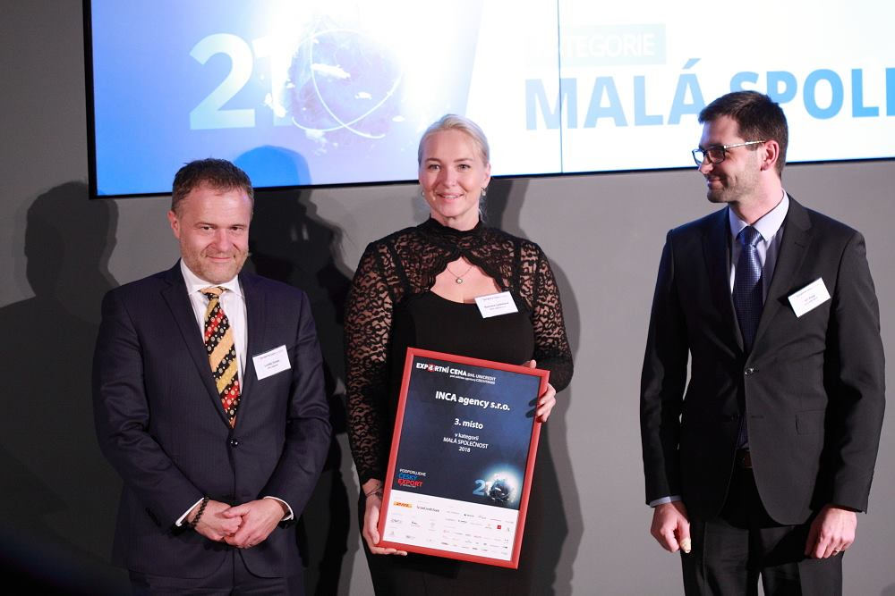
Export success
We care for quality of every lot to keep the biological value and effect on a constantly high level.
In 2018, Inca Agentur was awarded the export award DLH for exports outside the Czech Republic.

Slide 10
What worked in the Czech Republic and in Slovakia? Storytelling and education
The main target of your marketing is quality content looked for by customers.
Our ads were published predominantly in lifestyle media, health-focused media and expert media. A combination of these channels leads to a better selling performance.
Besides publishing the traditional health topics, we published the history of the founder Romana Ljubasová. It is a history of a successful women with a hard journey behind her, before she discovered this miracle, which she enchanted into the blue box.

Slide 11
Focus on Content Marketing
We inform the public about the necessity to replenish collagen in the body and that's why we continuously publish articles in various media.
Helissa Collagen became a product used in the beauty and health care sector.
In the pharmacological segment, we developed to a brand recommended by big pharmacies.
We process keyword-oriented topics searched for by the public
We spread our messages through digital media

Slide 12
Focus on Content Marketing
• The advertising mix covers ads, personal sale, public relations, direct marketing, interned and online marketing. These tools inform the target group about the existence of this product and advantages, it offers to the customer.
• Web content, social networks and media grew. The brand became known thanks to social networks and lots of education of customers presented by various types of media mix.
• We often participated in various beauty exhibitions in Prague and Bratislava, we held lots of presentations and training events for resellers and pharmacy employees.

Slide 13
Why Helissa Collagen?
• Bio-activity – the human body works with it as with its own collagen
• Highest collagen quality in the Czech market
• Best price-performance ratio
• 3 000 mg of bio-active sea collagen in the daily dose
• 100% sea collagen of type I, II, and III
• With neutral taste, no colouring, no chemistry, only pure collagen
• thousands of satisfied customers all over the world
• minimum shelf life 4 years

Slide 14
How does Helissa Collagen work?
The human body works with it as with its own collagen. After absorption, it distributes it and uses it based on its actual needs. Besides it, it stimulates own collagen production – this effect continues up to 12 weeks after Helissa Collagen intake end.
Helissa Collagen is produced by mild hydrolysis from sea fish. It is 400times more effective than the common collagen preparations. The daily dose amount is very important. Helissa Collagen is a high-quality, strong, bio-active collagen.

Slide 15

Cosmetic effects
Smooths wrinkles
Heals cellulitis and stretch marks
Slows down skin ageing
Heals atopic eczema and psoriasis
Improves clearly hair and nail quality
Bleaches pigment stains
Heals acne and varicose veins
Smooths edges of old scars and heals new scars

Slide 16
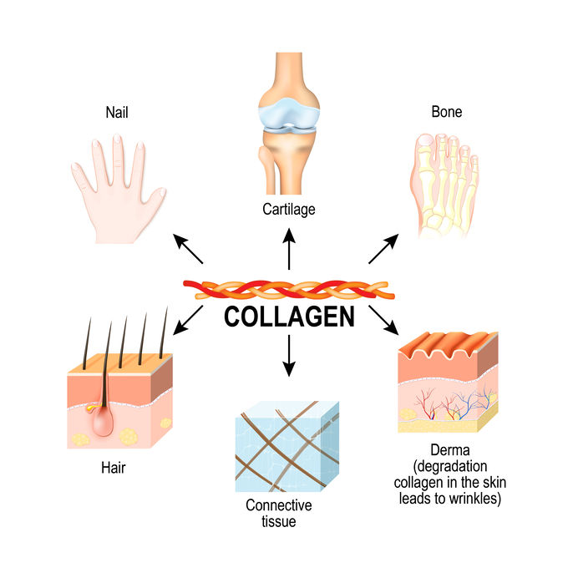
Health effects
Mitigates bone and joint pain caused by arthritis and rheumatism
Regenerates joint cartilages
Helps in case of chronical backbone pain
Heals varicose veins and crural ulcers
Heals scalds, frostbites, scratch wounds, decubitis and bruises
Positive effect on the condition of mucosa, antimycotic effect
Slows down bone thinning at the beginning of osteoporosis
Mitigates nerve pain and chronical bone inflammation

Slide 17
Marketing and media
It is necessary to invest in advertising and presentations. Before Christmas 2015, we invested into our first promotional campaign at first € 1 000. It was a success. The year after, we spent more than € 10'000 for campaigns including Saint Valentine's Day, spring and summer campaigns.
In 2017, about € 30'000 were necessary for online and offline activities. Now we focus mainly on online marketing and influencers.
In 2018-2019 we followed the rule that quality is more important than quantity, even in case of influencer marketing and in various media channels

Slide 18
Marketing strategy
Participation in exhibitions, training of pharmacist and resellers
Support for resellers through their own marketing activities
Giveaways and advertising presents, evaluations, tests
Seasonal activities (summer and holidays, Blue Monday, Christmas, Saint Valentine's Day, Women's Day, company anniversary)
Own newsletter
Social media contributions with influencers and prominent personalities
Branding of our company cars
We are number on in the Czech and Slovak markets (15 million inhabitants), we do not try to copy our competitors, but often competitors copy us. This means, we do it well. But the product cannot be copied, particularly not the energy and love we invest into it.

Slide 19
The most important marketing instruments – offline
1Vitamin C free-of-charge: Conditions – timely limited event for online purchase through the e-shop at the start of selling. It can be repeated
Samples of Helissa Collagen: Shopping through e-shop (timely limited – can be repeated)
4times per year competition in the social networks, a present set with collagen (various giveaways, several winners) is the price for the winner
We shall provide the shop with brochures about new products in the market. Even ads in the newsletter could be possible

Slide 20
The most important marketing instruments – offline
5) Publication of serial PR articles on various topics (seasonal topics, sports, maternity, sun bathing) with strong content and arguments, why Helissa Collagen.
6) As in the CZ and SK, we will contact strong influencers on Instagram and provide them with the product for promotion and testing
7) We shall participate in marketing activities. What are the options?
8) (Blog, banner, competitions, evaluations, examples events)

Slide 21
Strategy and Media Mix
  SEO - content- blog - testimonials - references
  PPC - Google ads
  Social media - FB, IG, YT
  Influencer Marketing - prominent personalities
  Presents for testing
  Health-oriented media (websites focused on food and beauty supplements)
  • Lifestyle media
  • Media oriented on women
  • Media oriented on sports (regeneration and food supplements)
  • Specialised health-oriented media

Slide 22

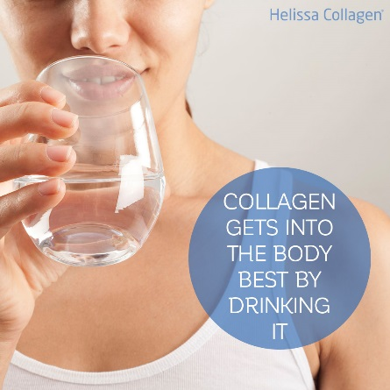

Strategy for you
  The main topic – brand popularity – new brand in the market
  Ads in magazines, brochure, newsletter
  Additional presents added to orders
  Presentation in the shop – testing, trying in the shop
  Samples and tests
  Online competitions for customers
  Blogs and PR articles with native advertising content
  Phrasing why your body needs collagen
  Target group of customers: women – mothers

Slide 23
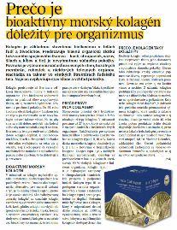
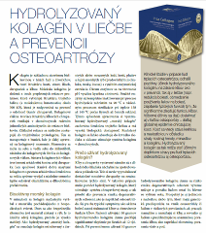
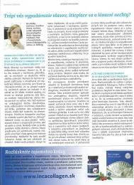
They wrote about us
Helissa Collagen became a product
used both in the beauty and health sector.
Helissa Collagen participated in expert congresses, seminars and events.
Marketing publications were published in renown pharmaceutical / medical media as well as in patient-oriented media.
In the pharmacological segment, we became the collagen recommended by big pharmacies (Dr. Max, Benu)
At present, we work on studies on skin elasticity and humidity monitoring.

Slide 24
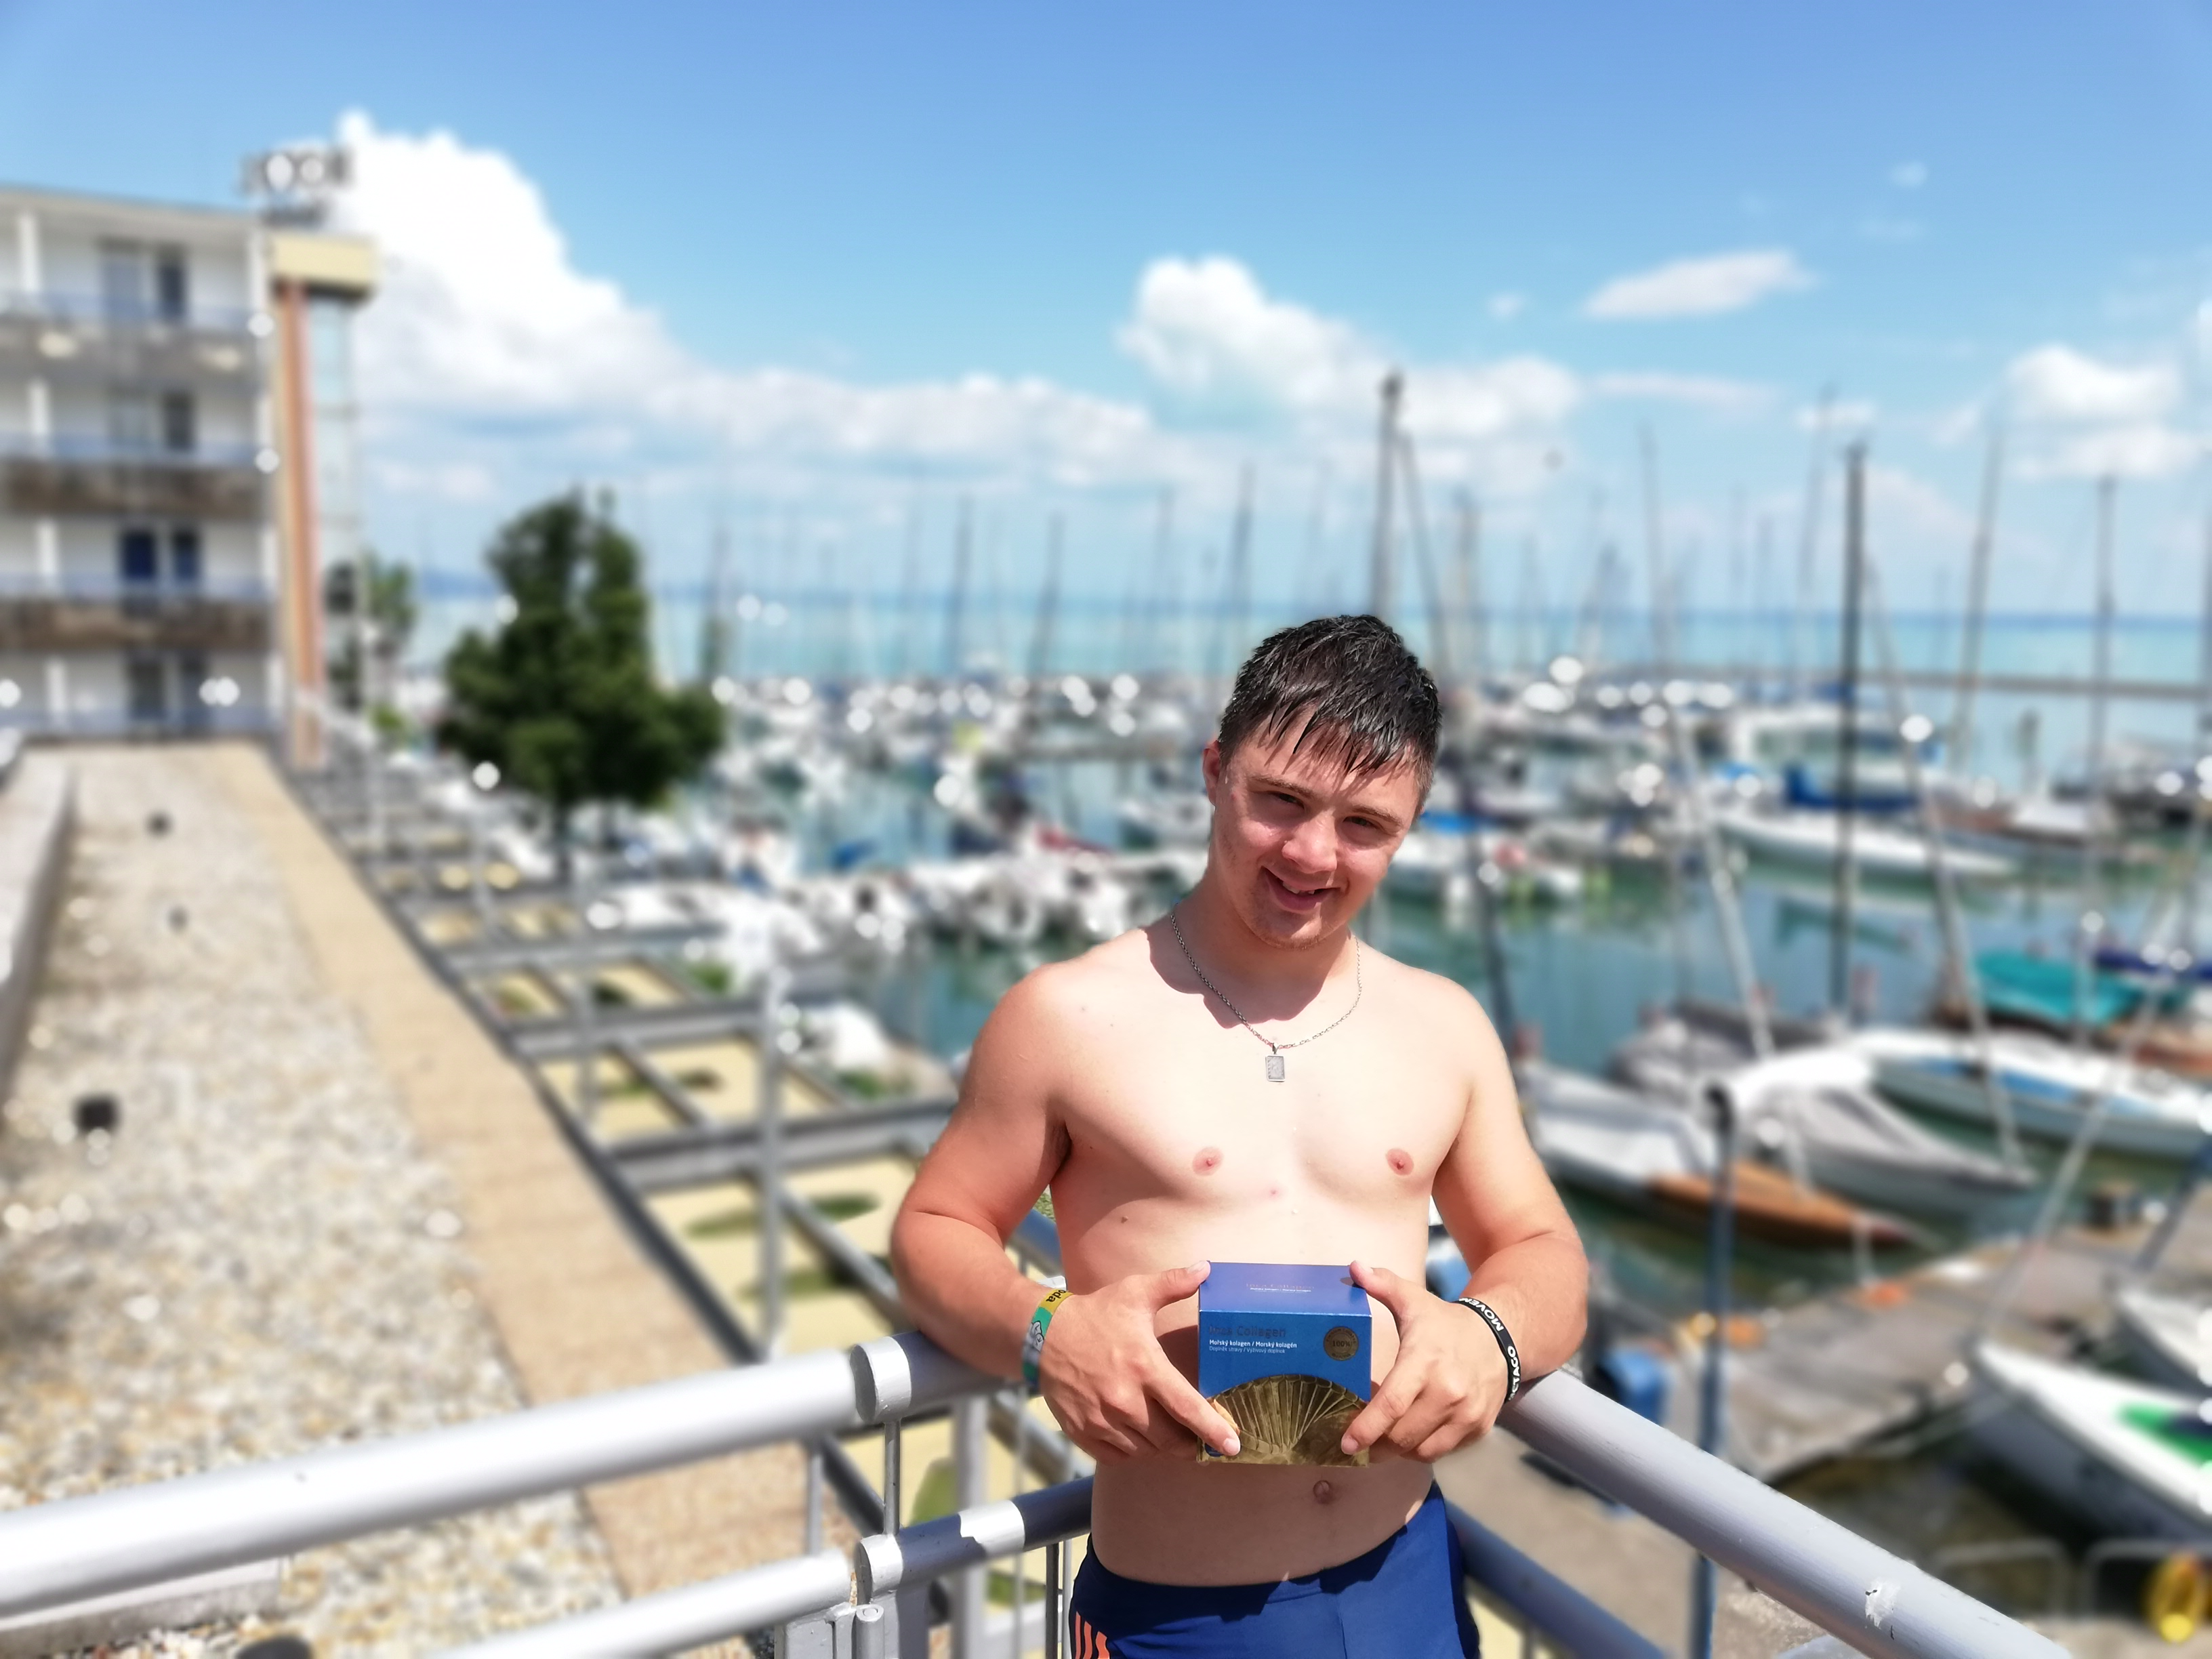
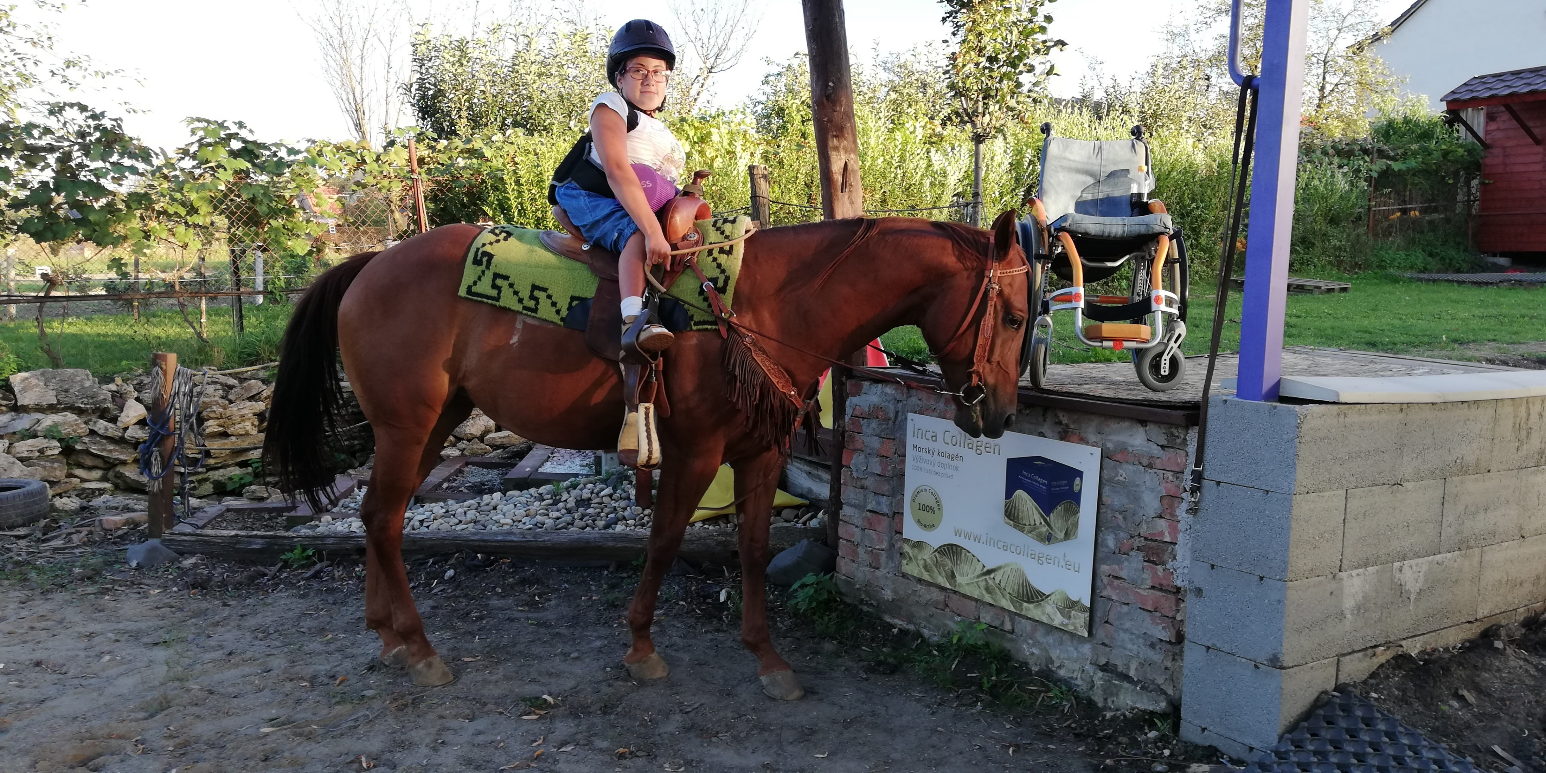
Collagen that really helps people
As the brand owner, Romana Ljubasová has contributed also a piece of herself into the company philosophy – the idea of mutual help for others.
Due to this reason, Inca Collagen supports DEBRA, a patient organisation supporting the butterfly disease association, further the Animal Freedom Shelter as well as hippotherapy for handicapped patients with the Down syndrome.

Slide 25
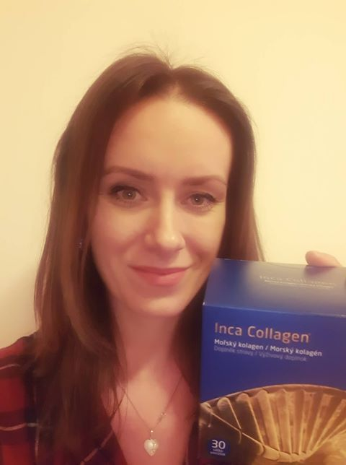
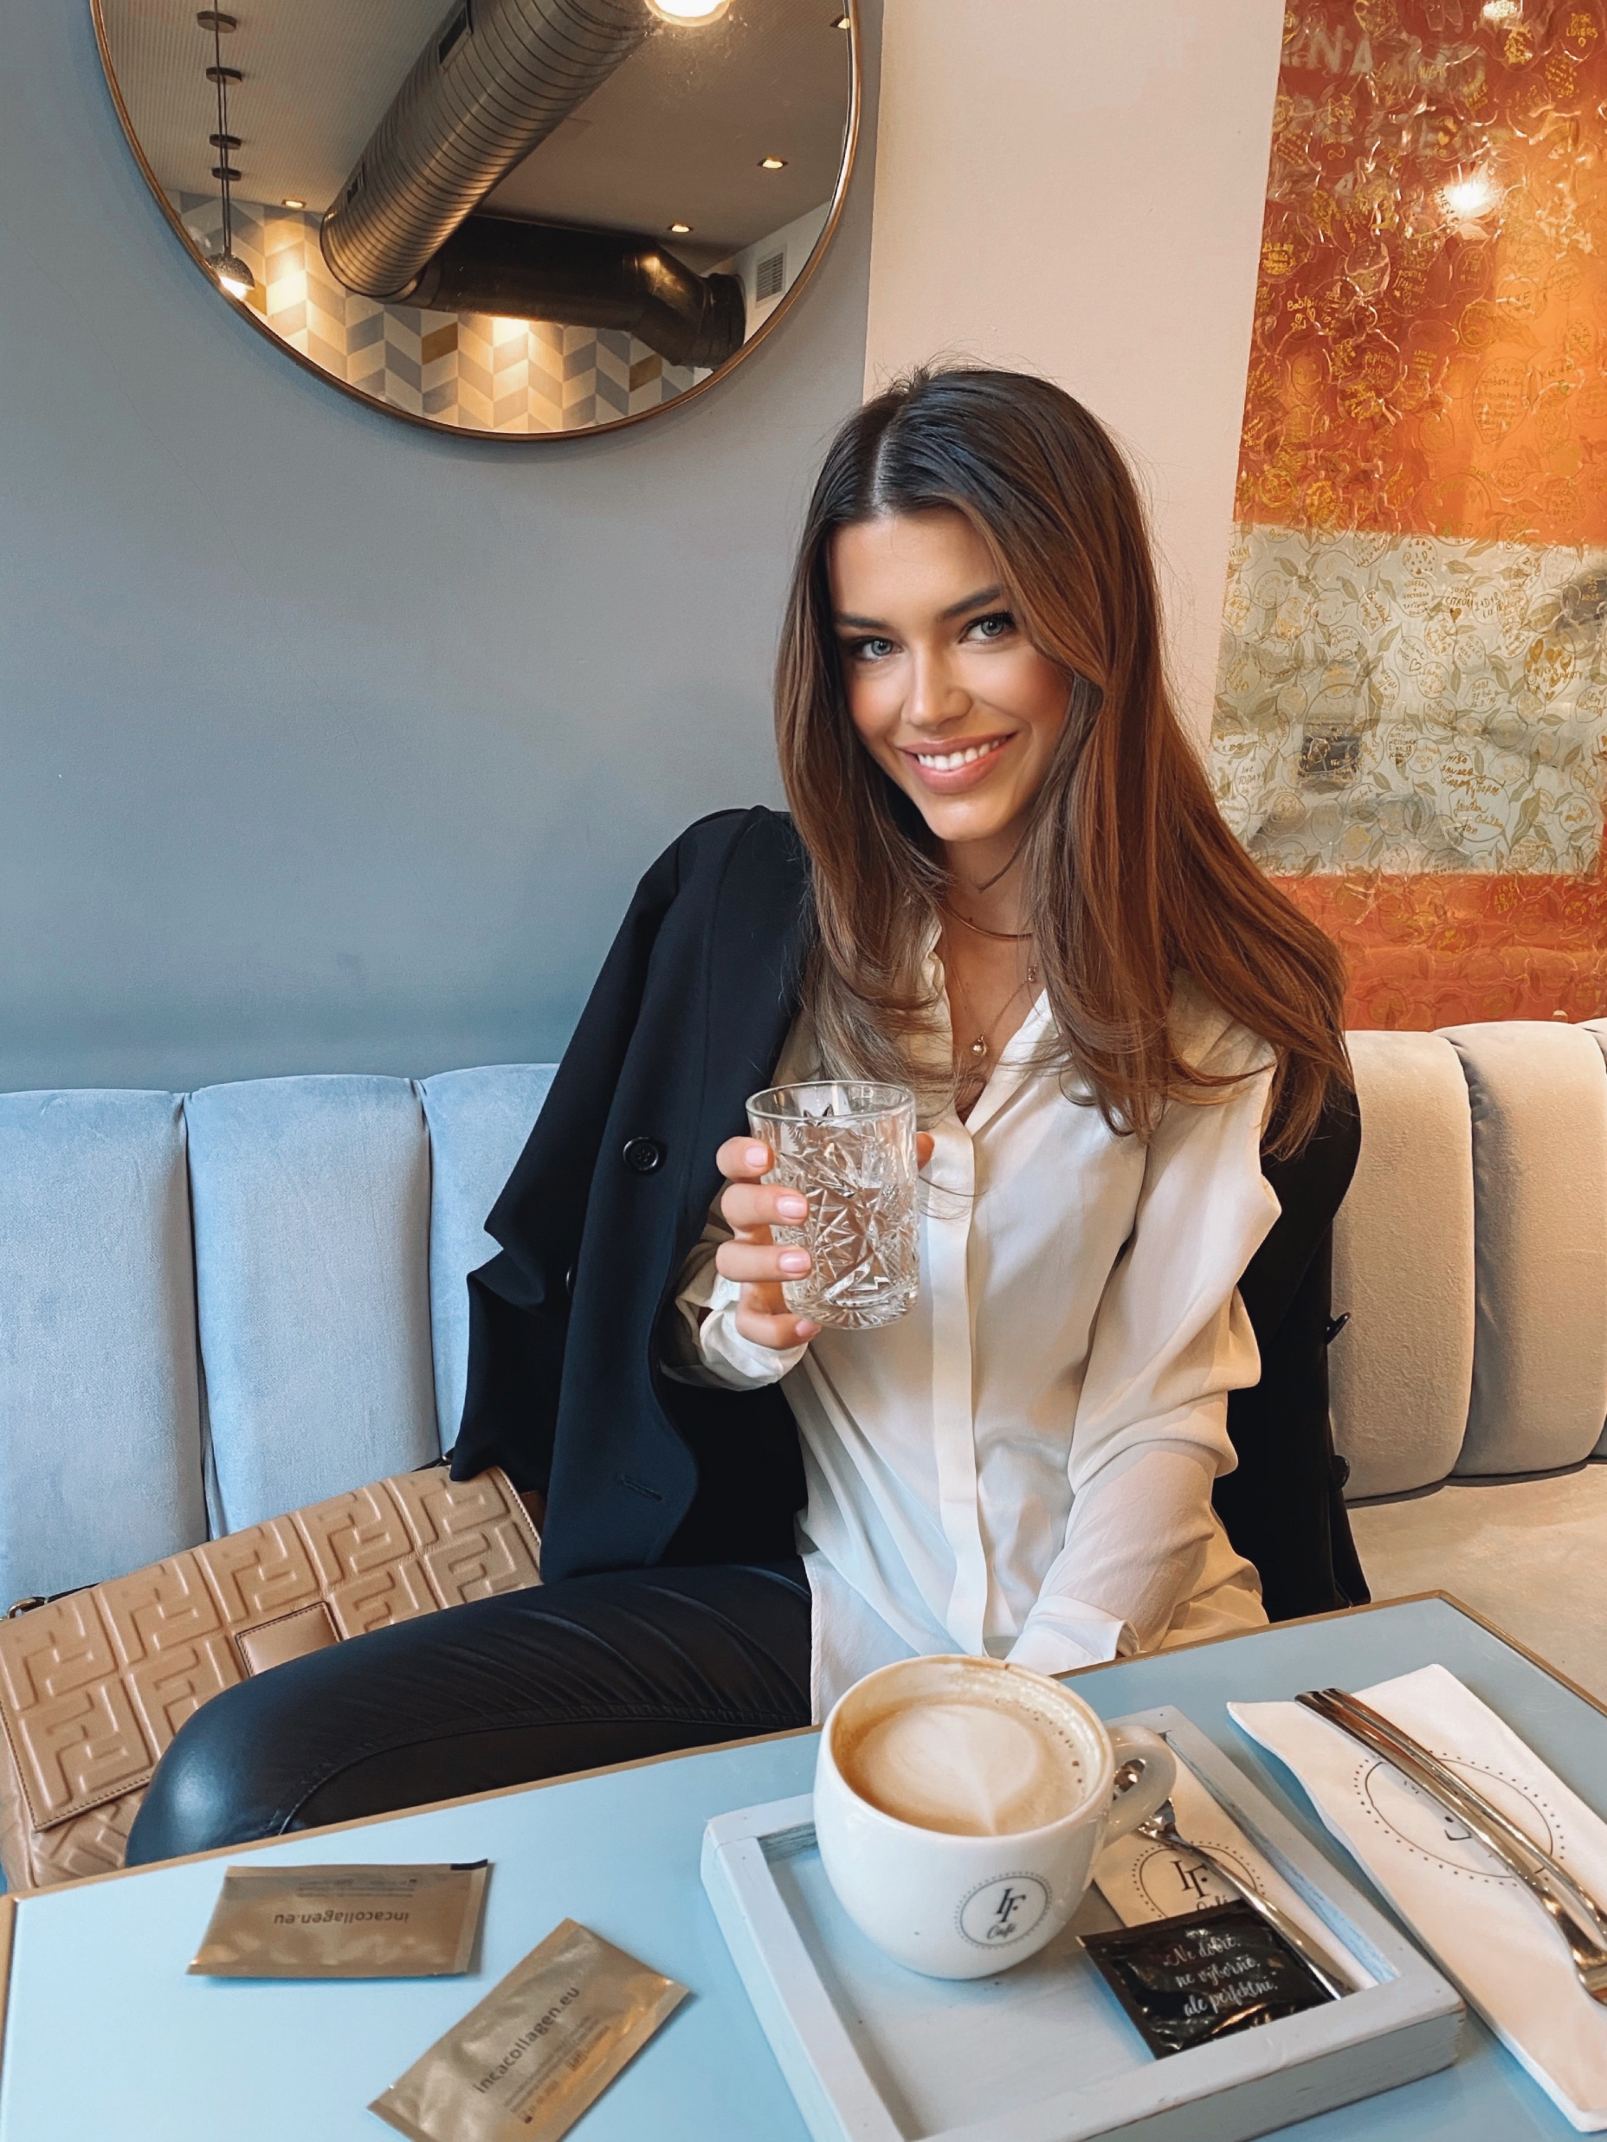
Testimonials
Paula: Hitherto, I consumed two boxes and I am extremely satisfied with it. Now I can see results – my skin is more shining and less saggy, with less wrinkles and other imperfections. At first, I started with it due to hair loss and bad hair quality. Even after the so short time, my hair became thicker and less brittle. After three children, I took various vitamins, used various hair waters and various shampoos, but Inca Collagen really helped me. The advantage consists also in the fact that one can take it simply at any day time in a glass of water. Naturally, I shall continue to use it and I can only recommend it.
Karolina Chomistek: Supermodel
I have teen taking Helissa Collagen for quite a long time and since, my hair loss is gone. I also feel like the quality of my skin improved. My Helissa Collagen drink is a part of my daily morning ritual.

Slide 26
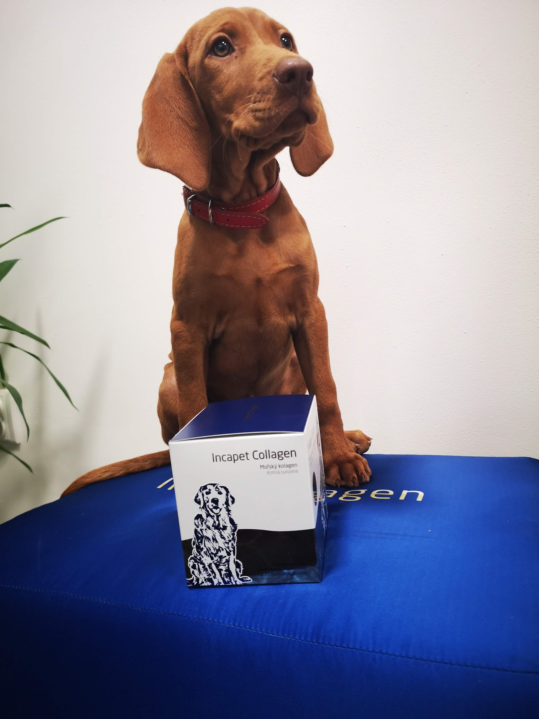
Collagen also for animals
Animals suffer also from lack of this essential protein. Your pets shall feel the advantages of regular replenishing of high-quality bio-active collagen quite soon. The Inca Collagen brand introduced also a high-quality hydrolysed three-component collagen under the name Incapet Collagen. It is destined for three different animal species – horses, dogs and cats.
With some humour one can say that effects of this collagen were tested on humans to serve animals. Incapet Collagen helps e.g. to keep a healthy locomotion system of dogs, healthy joints and bones of horses and healthy shining fur of cats.

Slide 27
Effects of Incapet Collagen
Helps to strengthen cartilage, soft tissues and joints
Helps to strengthen bones
Improves fur quality
Improves claw quality
Helps to strengthen teeth
Helps to heal and regenerate skin after skin afflictions
Accelerated wound healing after surgical intervention and injuries
Supports general regeneration of animals exposed to high physical load
Considerably improves mobility of elder animals
Supports healing of injuries as surgical interventions, deformations, joint swelling, aching joints, degenerative and other joint ailments, hip dysplasia or other dysplasia types, kneecap luxation.

Slide 28
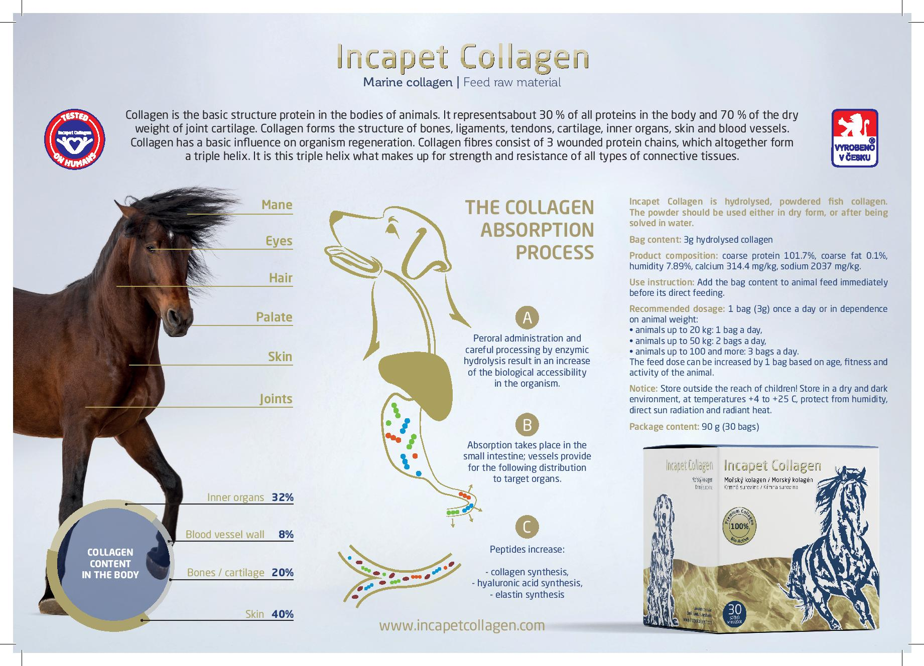
Effects of Incapet Collagen

Slide 29
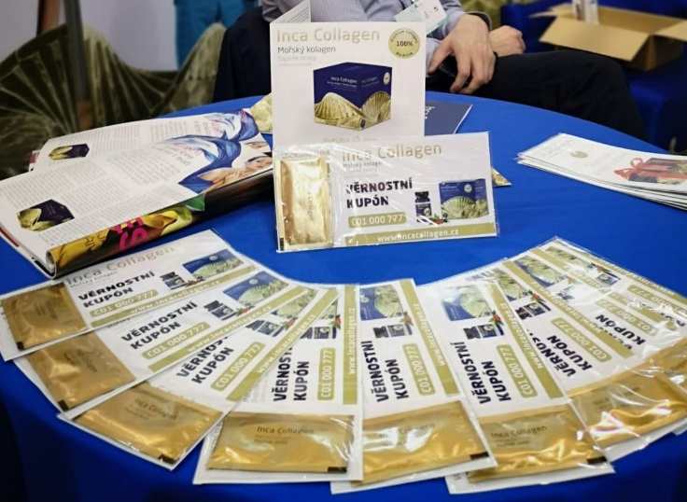
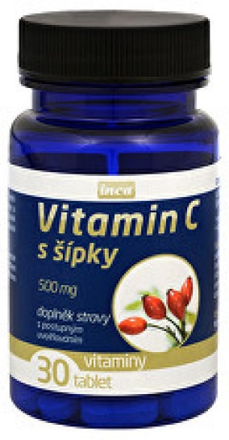
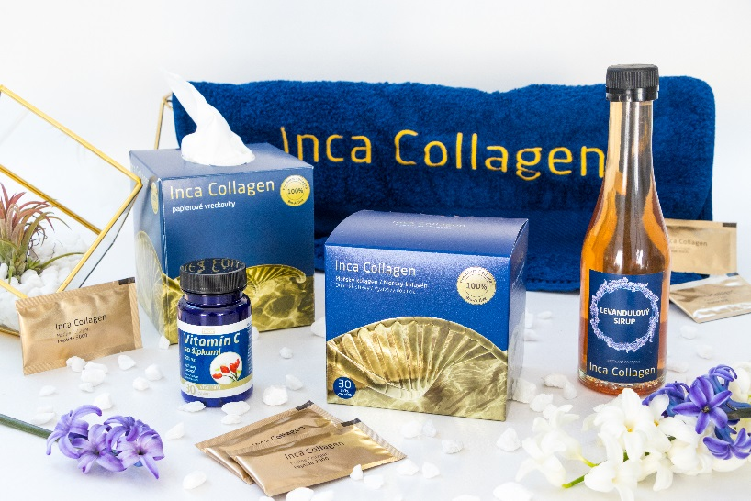
Samples

Slide 30
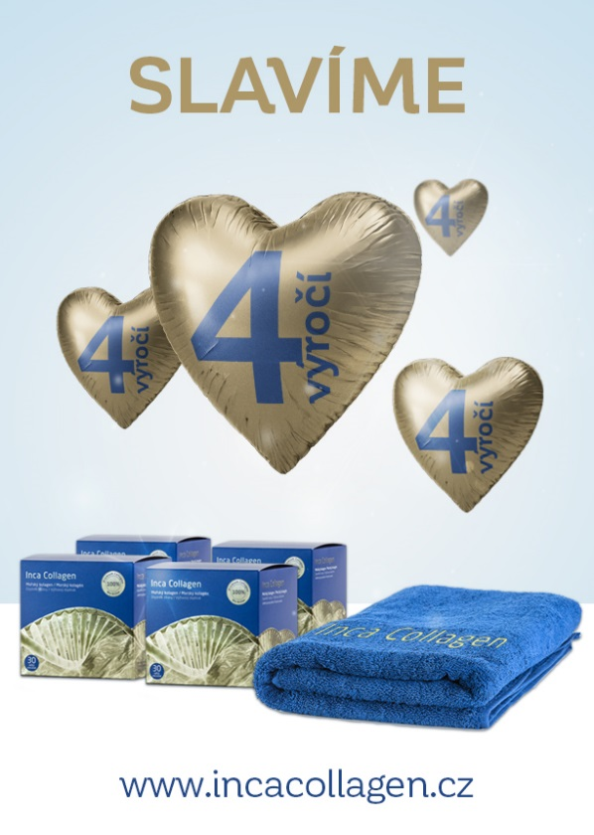
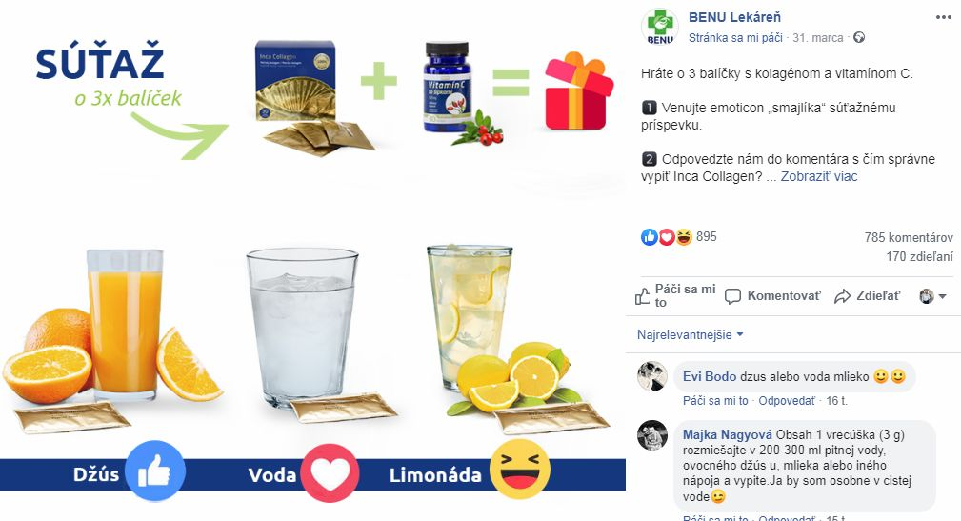
Newsletter & Facebook posts

Slide 31
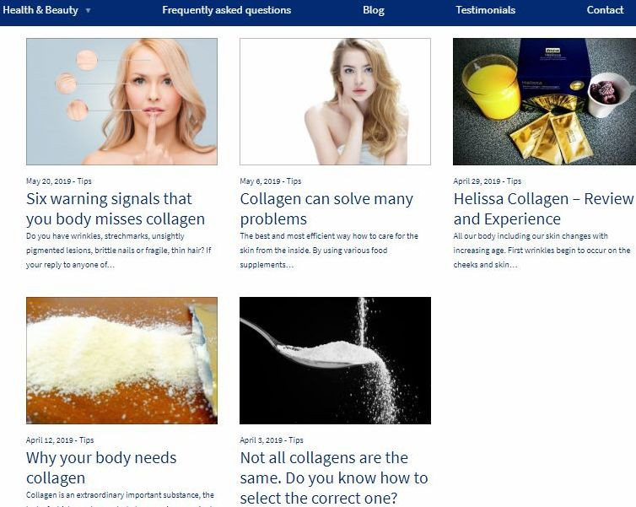
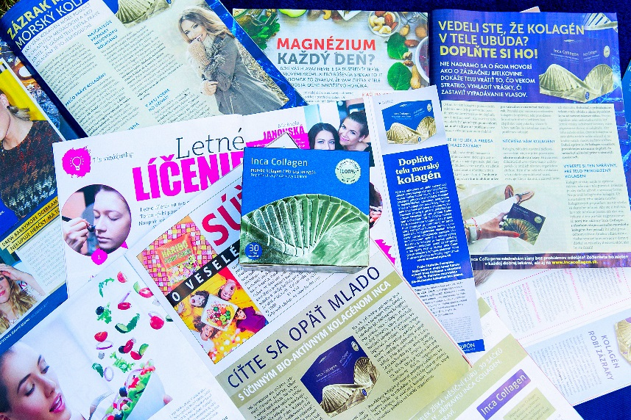
Strong content

Slide 32
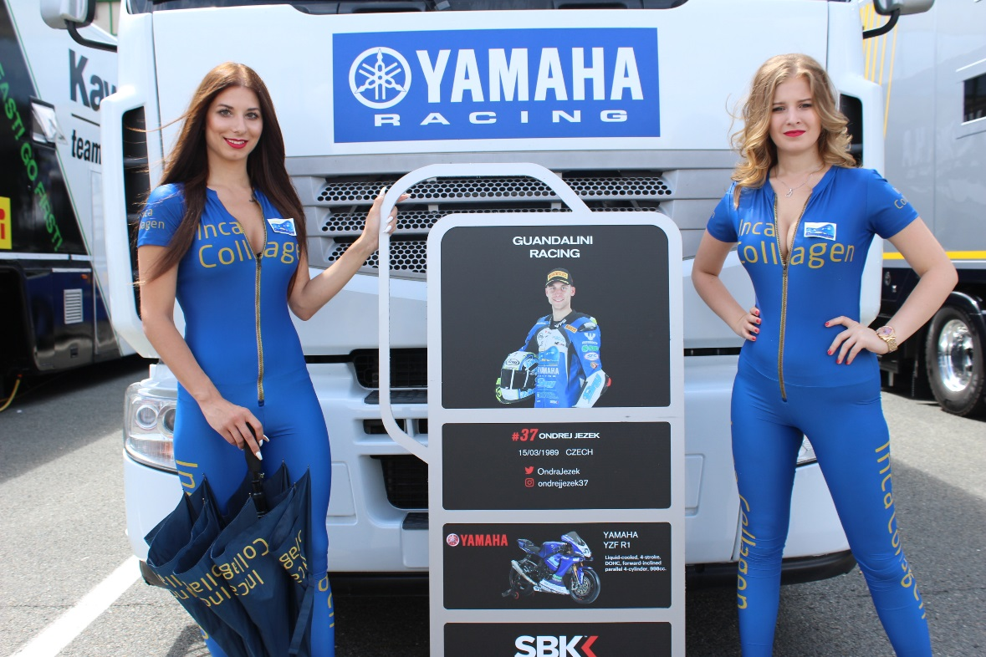
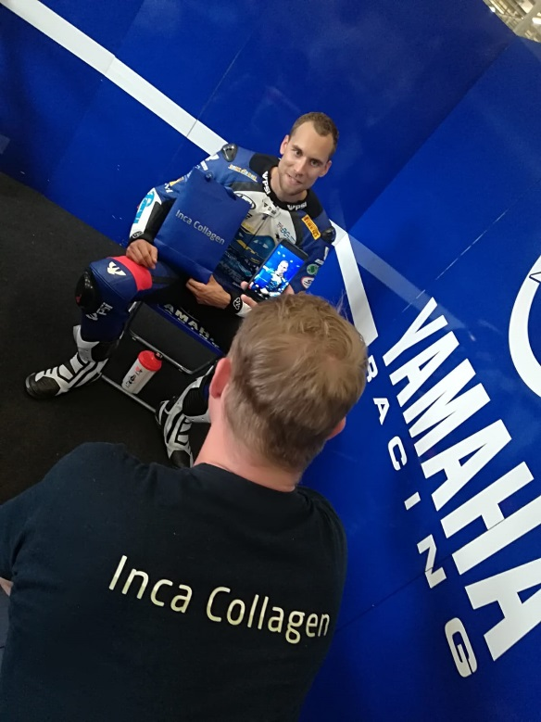
Support of motorcycle racer and collagen
We sponsored the motorcycle racer Ondřej Ježek in the WSBK series .

Slide 33
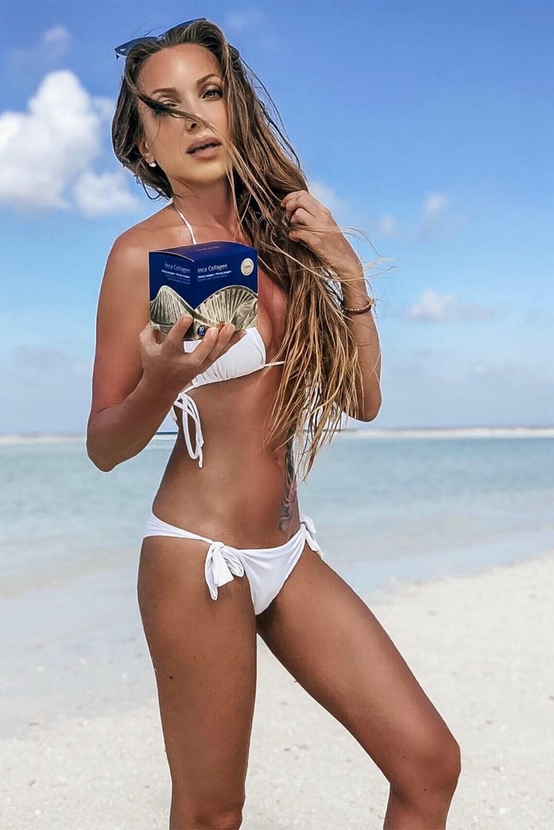
The face of Inca – Helissa Collagen in SK & CZ
Jana Pištejová
famous fashion designerNatürlich schöne Dame
Age 35+
More than 46,9 Followers
collagen improved her hair strength and resulted in shiny skin
https://www.instagram.com/pistejka/

Slide 34
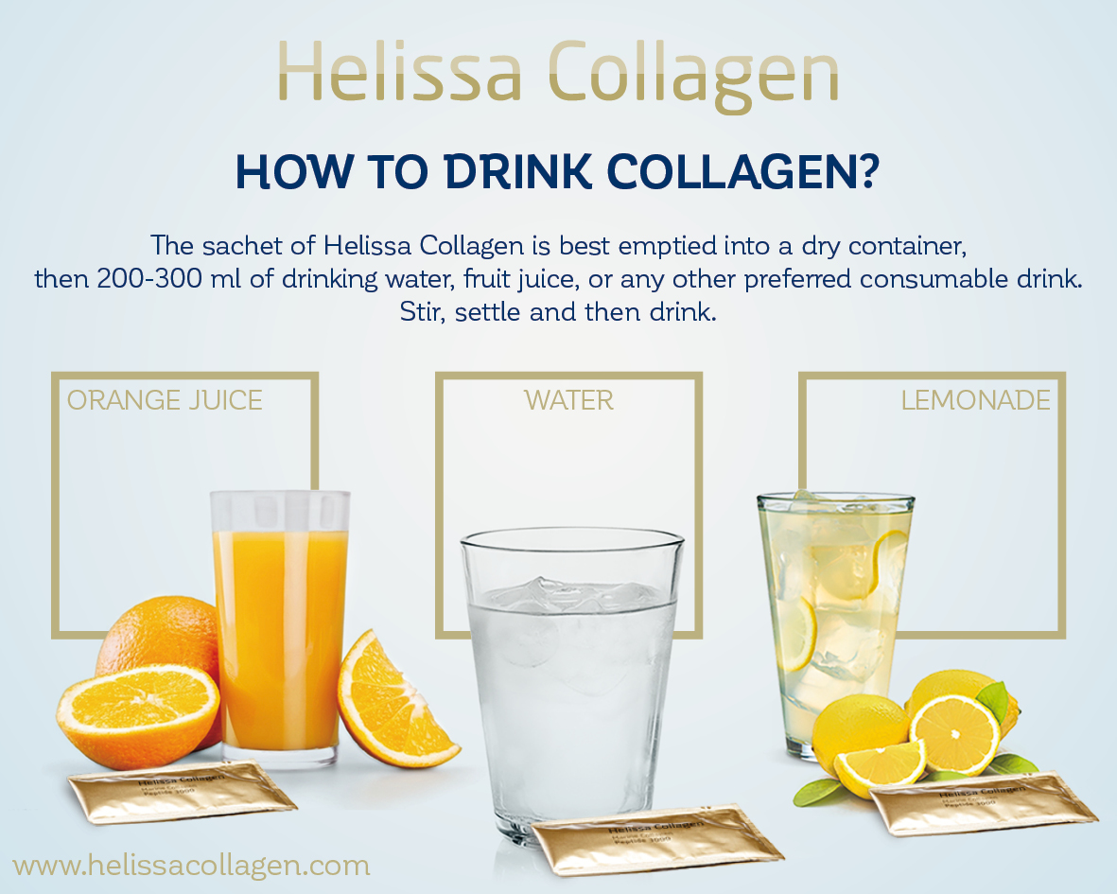
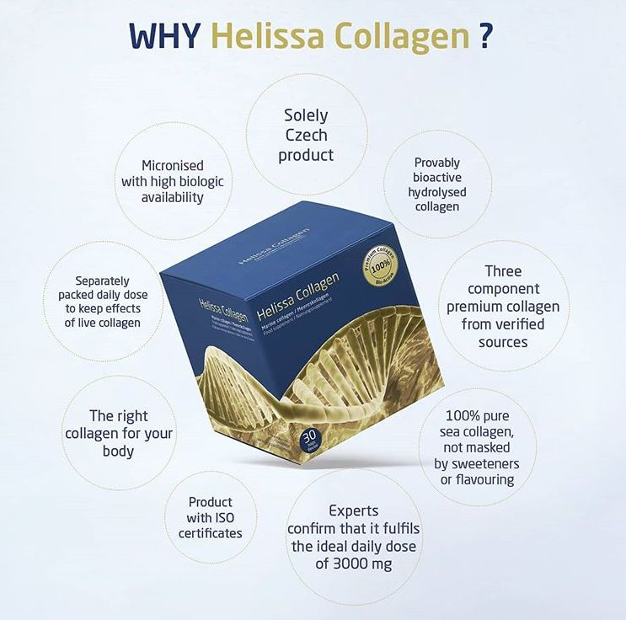
Examples of leaflets

Slide 35

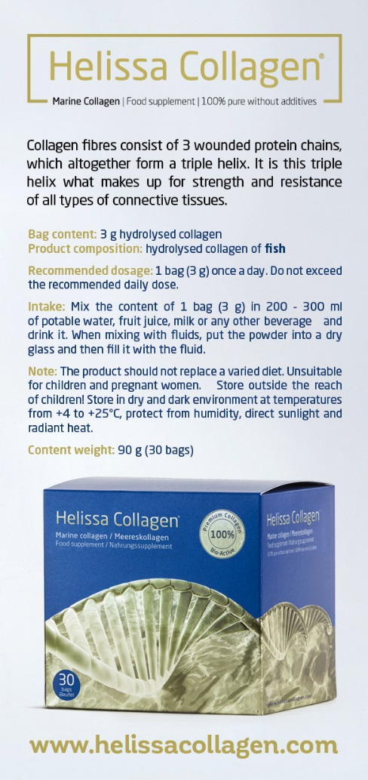

Examples of leaflets

Slide 36
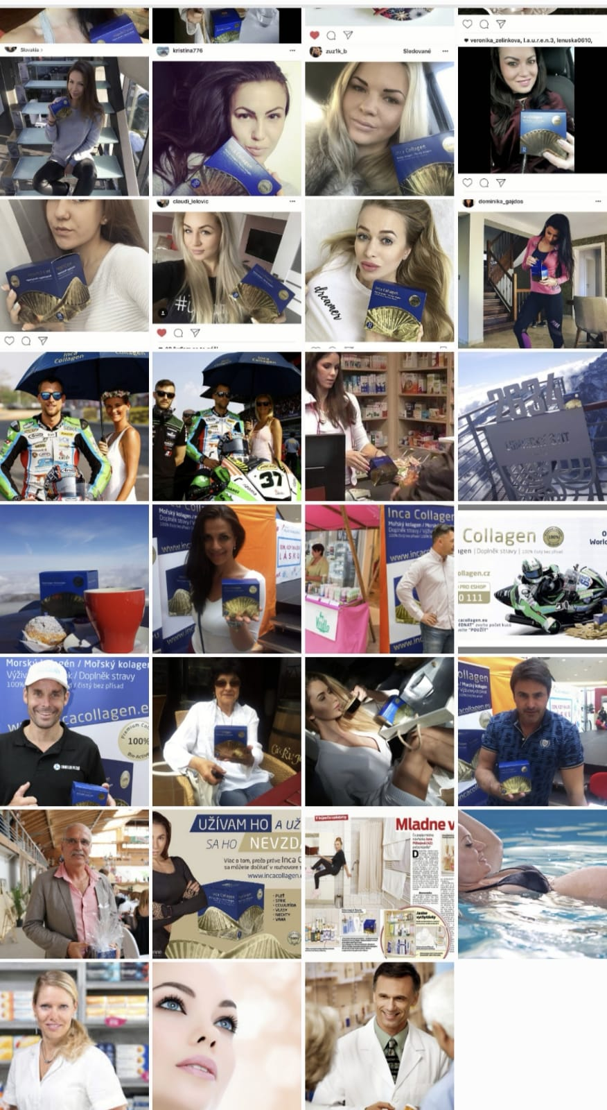
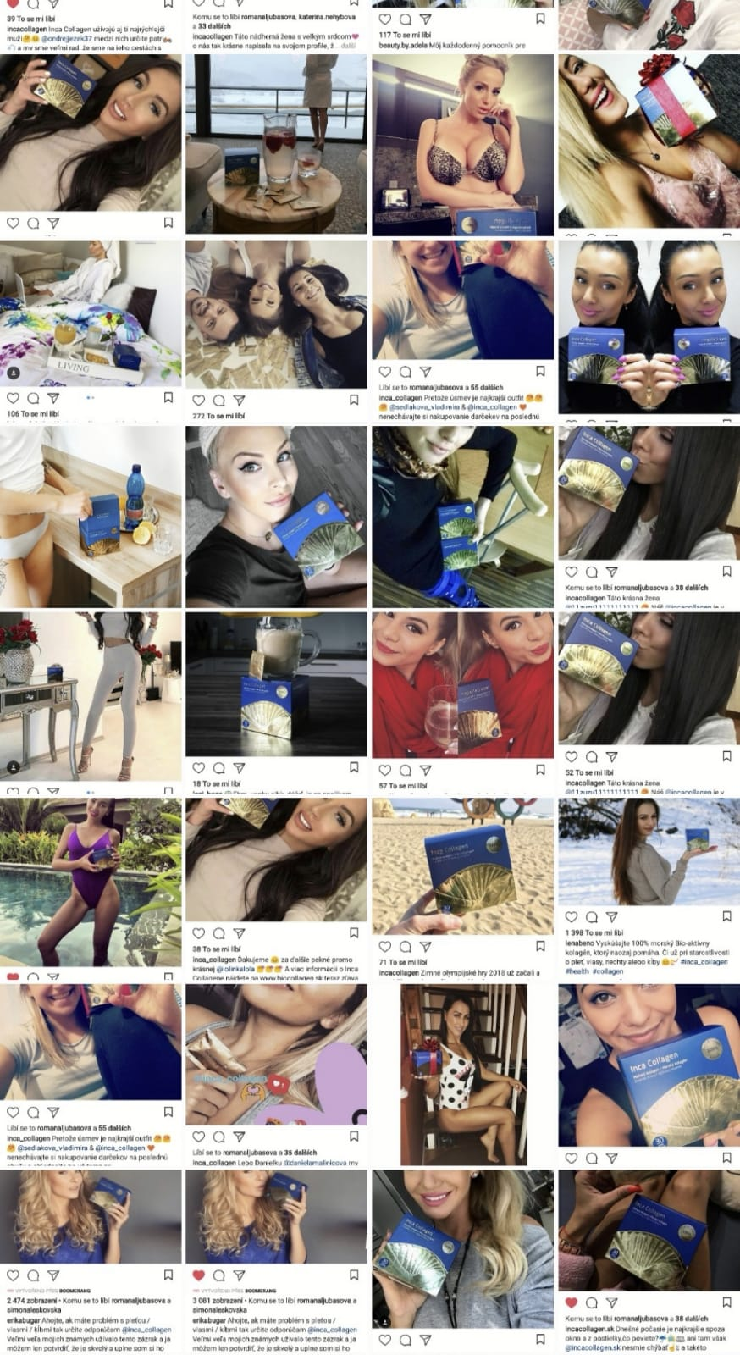
Instagram-Testimonials

Slide 37



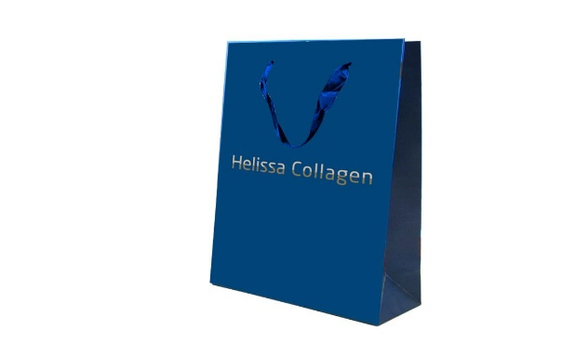
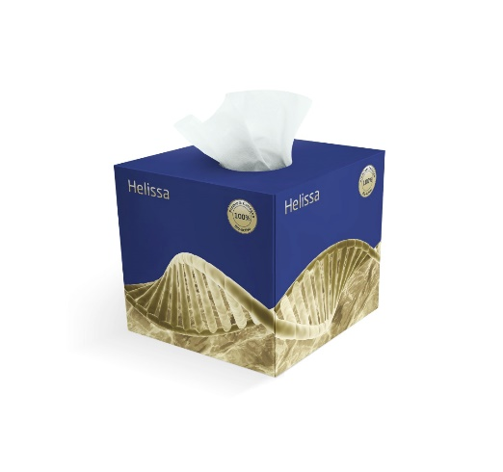
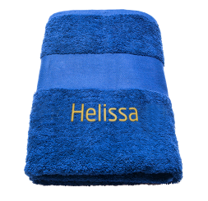
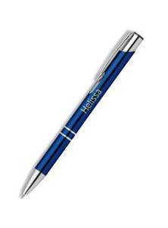

Examples of gifts

Slide 38
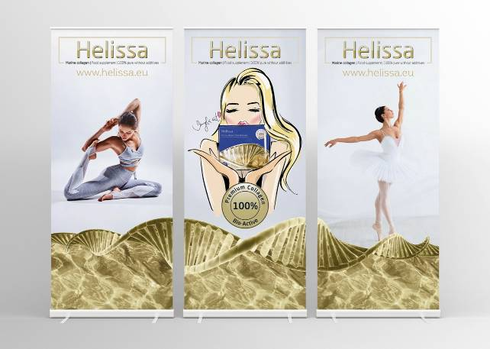
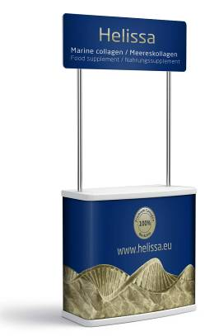
Presentations for Events

Slide 39
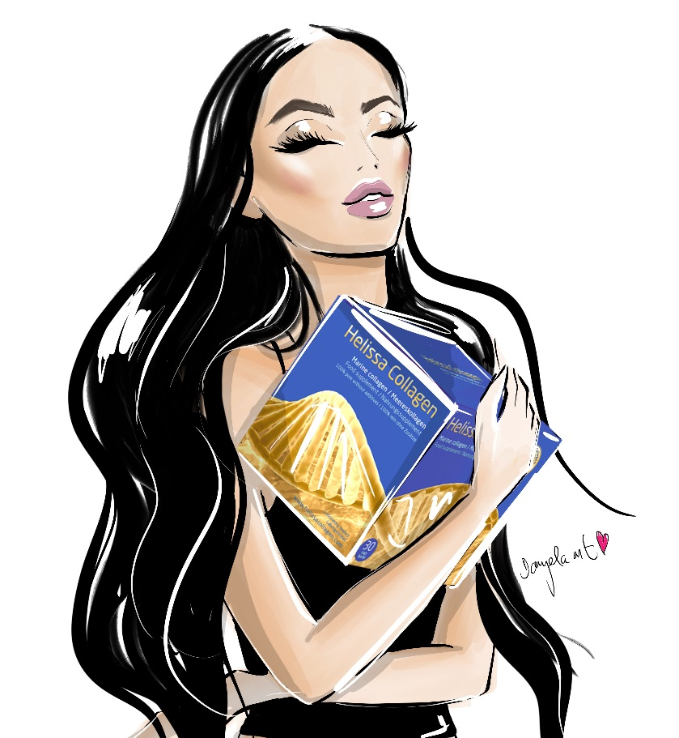
Contacts
INCA Collagen s.r.o.
Zborovská 906/11
Brno
Czech republic
www.helissacollagen.com
info@incacollagen.eu
IG: helissa_collagen_official
FB: helissa_collagen_official
YT: Helissa Collagen

